Slide 1
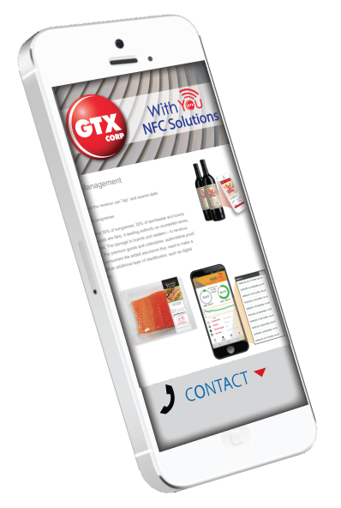
“Tap and Track” For Shipping, Logistics, Supply Chain & Asset Management
The Data you Want – The Data you Need
For Todays Mobile Digital World
This Information Is Proprietary To GTX Corp and its Subsidiaries and May Not Be Copied Or Transmitted Without Prior Written Permission . 2019

Slide 2
Where Is My Stuff? How Did It Get There? Is It In Good Condition?
Veritap was founded with the mission of solving
the greatest problems facing the logistics industry today.
VISIBILITY
The #1 obstacle that supply chain leaders are looking to overcome is the lack of transparency and visibility
TRACKING
No unified system or method to track intermodal cargo. Billions of dollars in economic loss stems from freight tracking issues
FRAUD
$30 billion in annual losses due to freight theft in the U.S alone according to the FBI, increasing consumer pricing by upwards of 20%
RECALLS
Lack of visibility often leads to lack of granularity in recalls. Our goal is to be able to provide surgical recalls.

Slide 3
Tap, Track & Trace Along the Entire Supply Chain From Source to Consumer
'Tap' your NFC-enabled smartphone or tablet to an NFC-enabled asset and instantly access useful information and data. No scanners or wires required to use this simple, intuitive technology. Bring Your Own Device (BYOD) to Tap and Track Actions, Assets, and Data, and connect your users to a world of information and convenience.
Manage all your valuable shipments and documents right from your device. Imagine your Bill of Lading authenticated at each point of departure and entry. With all your data securely stored and accessible from the cloud.

Slide 4
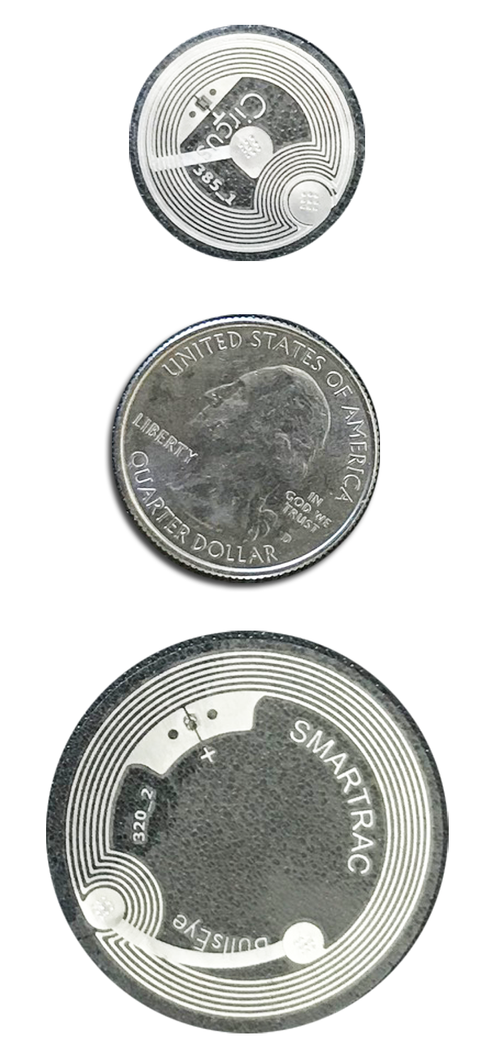
What is NFC Tap & Track?
SHOWN TO SCALE
Near Field Communication (NFC) is a standards-based short-range wireless connectivity technology that makes your smartphones, wearables, tablets and other devices even smarter. NFC is built into more than 2 billion NFC-enabled devices and is compatible with hundreds of millions of contactless cards and readers.
For example, briefly touch (or ‘tap’) your NFC-enabled smartphone or tablet to another NFC-enabled device and instantly access useful information and data. No scanners or wires are required to use this simple, intuitive technology. All you need is to Bring Your Own Device (BYOD) and you can use NFC Tap & Track technology to connect your users to a world of convenience, information, enhanced experiences and intelligence.
With NFC Tap & Track you can increase efficiencies and achieve costs savings by managing documentation and processes across the supply chain.
Mobile Engagement on the Ground, Actionable Data in the Cloud.

Slide 5
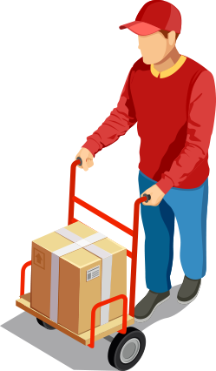
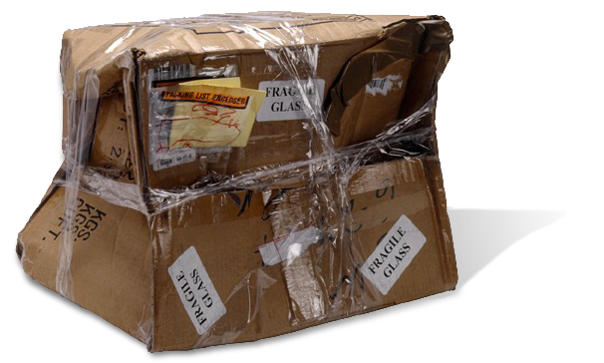
HOW DOES THIS APPLY TO LOGISTICS?
Transfer of Custody of Goods and Documents is where the Majority of Failures Occur
Non-fungible tokenization enables digital transfer of document ownership - no more paying for couriers for Bills of Lading. Send digital originals, which previously could not truly exist. Compliant with Rotterdam Rules for Electronic B/L
Prove transfer of custody in the real world with matching digital records that are notarized on-chain with proof of location, time, and previous ownership that cannot be forged. Record provable temperature and other conditions in transit.
Prove that damage did not happen in your custody, reducing insurance claims and increasing client and customer satisfaction. Notarized photos of deliveries and goods, particularly in final mile.
Prevent import of counterfeits through digital proof of authenticity of goods, through unique on-chain identities that cannot be duplicated or edited.

Slide 6
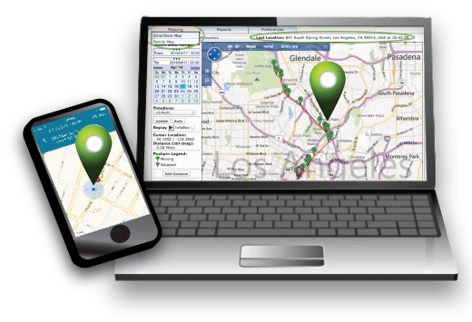
A Cost Efficient and Secure Track & Trace Solution
NFC Technology is a Global Standard
No Special Equipment or Readers Needed - BYOD
NFC Enabled Smartphones and Tablets
Does Not Require WIFI Connectivity
Encryption and Block Chain Supported
Cloud Access to Digital Documentation
Connecting the Physical and Digital

Slide 7
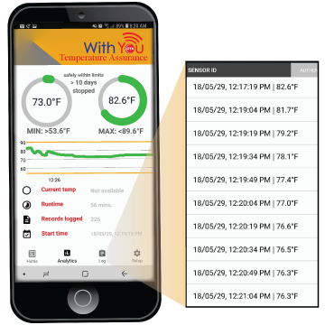
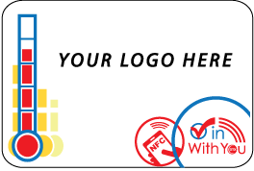
Secure Encryption & Blockchain Digital Mirror

Slide 8
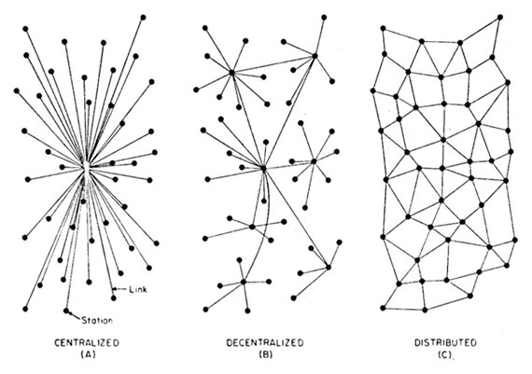
WHY BLOCK CHAIN?
Why are we building on an Open Blockchain Platform?
One way encryption algorithm, cannot be decoded, only compared against.
Open Blockchain Ecosystem
Decentralized, no one owns it. True blockchain technology.
Distributed, so highly resilient and maintains greater uptime than centralized solutions
Nearly impossible to tamper with, providing more secure and truthful audit trail
Data privacy guaranteed, significantly legally enforceable and verifiable
Data agnostic, universal, and unified.
“On Distributed Communications Networks”, Paul Baran, 1962

Slide 9
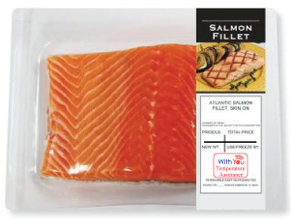
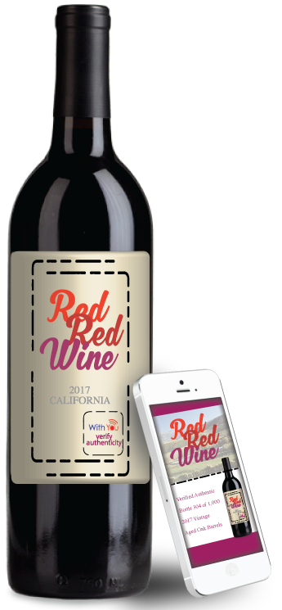
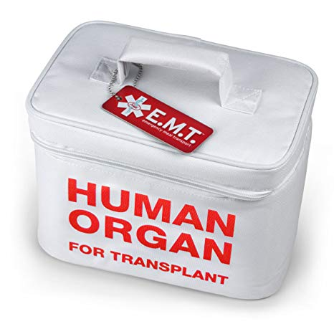
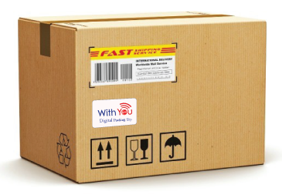
Key Issues in Supply Chain Management
ISSUE NFC CAPABILITIES
Exposure In Transit
Tampering, Counterfeiting
Traceability
Exception Management
Temperature Monitoring
Secure Authentication
Tracking point to point- regardless of mode, geography, or carrier
Real-Time Alerts for rapid response

Slide 10
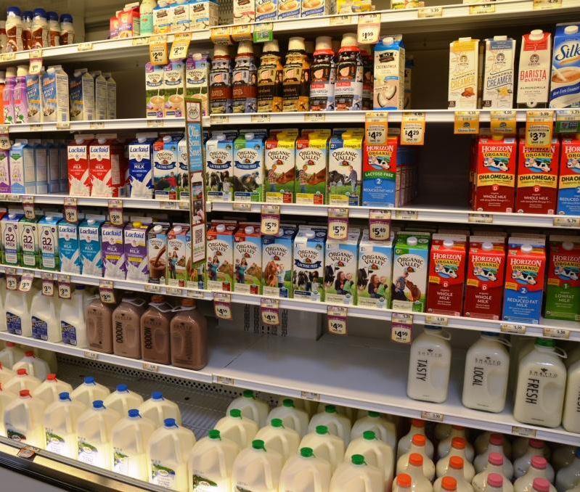
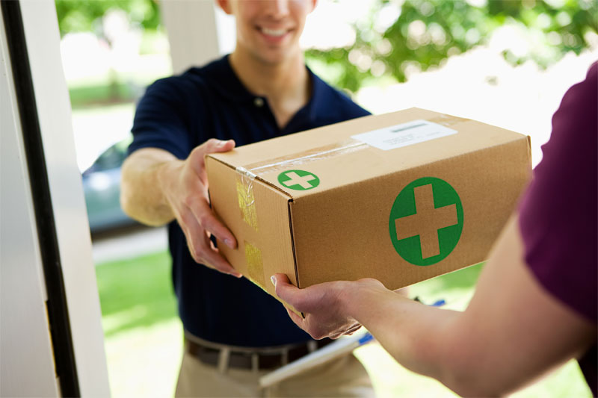
Use Cases
Perishable Goods
The distribution of perishable goods (including food, flowers, pharma, etc.) is subject to strict monitoring in order to guarantee product freshness and quality from the production site to the end user. Tracking the conditions to which perishable items are exposed as they travel from a field, factory, or farm to a store involves an expensive wired or battery-powered data logger that is accessed only when those products reach their ultimate destination. Tap & Track addresses existing challenges by using NFC technology to read and easily transmit vital information about the product; by simply using a mobile device, temperature records are transmitted to the cloud platform for analytics and risk remediation (and eventually, localization). For example, a truck driver could read the data upon dropping off or picking up a product shipment at a distribution center, and a retail store worker could do so at the receiving dock, ensuring freshness at any given point in time.
Pharma
More and more medicines are biologically engineered and require a temperature-controlled supply chain to ensure their efficacy is retained. Temperature tolerances are dependent on the time of occurrence and the actual product being shipped. For example, vaccines can easily become inactivated by an excess exposure to heat. If you are required to implement a cold chain distribution process on top of your GDP environment, or if you require proof of conformance in your custody chain, Tap & Track provides a proven solution to make it happen.

Slide 11
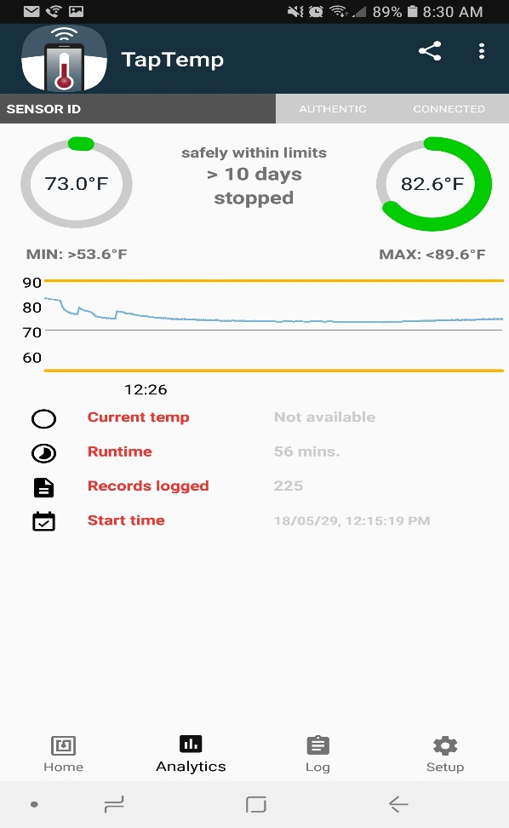
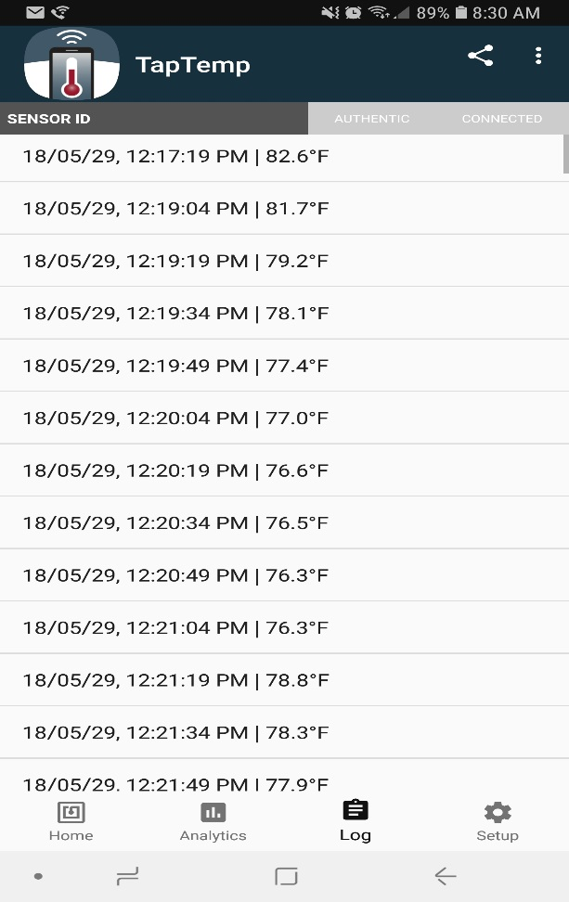
Assuring Product Quality
The quality of pharmaceuticals, food, beverages, agriculture, hazardous materials & other sensitive products can be affected by conditions in transit, such as temperature.
Our NFC-integrated sensors can provide real-time temperature sensing and data logging across the supply chain. Data can be read by an NFC-enabled smartphone.
Built-in security measures can prevent unauthorized modification of data logs, allowing brands, retailers, and distributors to verify quality by confirming that temperature-sensitive products were shipped properly.

Slide 12
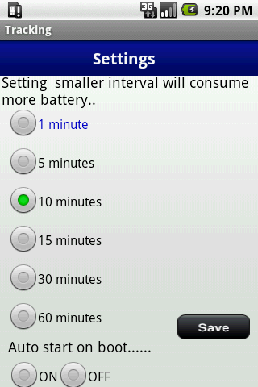
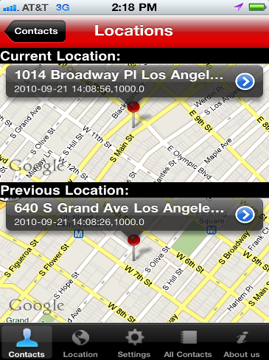
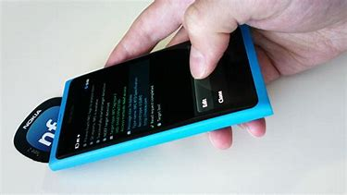
Easy to Use

Slide 13
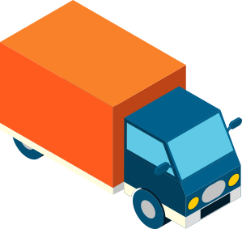
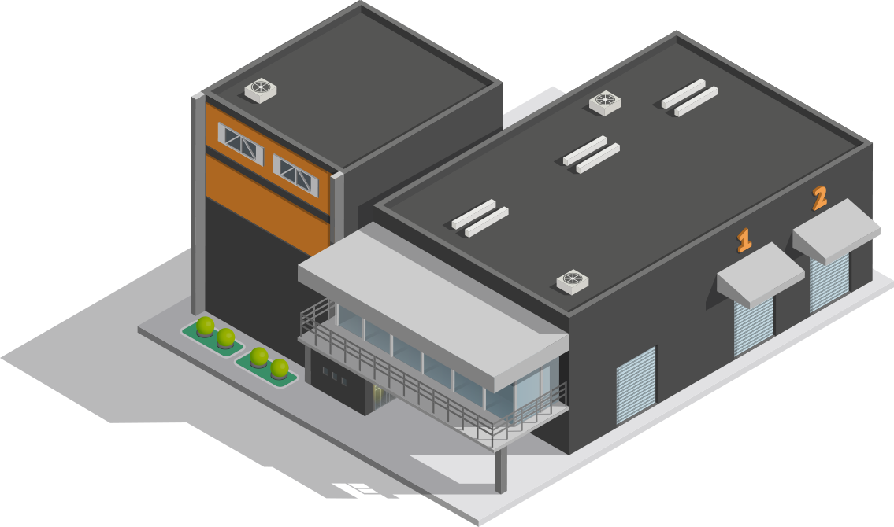
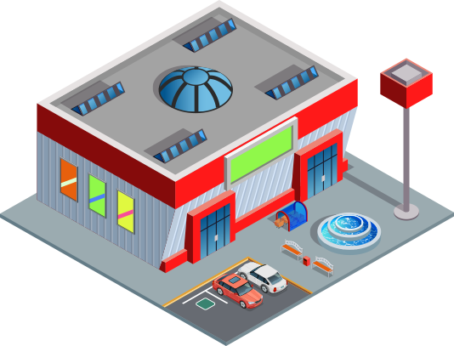
Use Case: End to End Food Track and Trace
- Feed production registered on chain
- Grain/feed production able to be input and traced by carload, lot, etc.
- Ensure certified correct feed inputs for receipt
- If necessary, monitor any conditions such as humidity of feed for spoilage
- Inbound shipment location tracking and traceability to improve efficiency
- Feed production registered on chain
- Grain/feed production able to be input and traced by carload, lot, etc.
- Ensure certified correct feed inputs for receipt
- Veterinary records added and certified on blockchain, effectively notarized and proven.
- Consumer-facing inputs can certify hormone-free and antibiotic-free.
- Append any processing facility certifications and notarize
- Processing conditions able to be added and tracked by lot
- Product is sold at retail, with blockchain traceability.
- Recalls can be narrowed, saving retailers time and money in the process as well
- Verifiable documentation including origin and others is securely transmitted to customs if needed
- Health documentation from Veterinarian securely and instantly transmitted
- Track condition of processed meat in transit, including temperature.
- Location and pickup info available and shared between Producer and Retailer or Purchaser
- Immutable audit trail for Producer on the ShipChain ecosystem
- Visibility for the entire lifecycle and supply chain
- End consumer receives product, has the ability to see more information about their food
- Consumer trust increased in process

Slide 14
Temperature Label Benefits
Even after battery life has drained, the tracker can still be used as a passive temperature sensor label, providing the present ambient temperature. The entire memory content, including the measurement values, are still fully accessible, eliminating the risk of data loss and enabling further applications even after the data-logging capability has stopped.
The sensor is also configurable — enabling frequent measurements for detailed logging or longer intervals to provide logging for extended periods — and can be calibrated to a customer’s application needs, providing a reliable and long read range using an ISO/IEC 14443 RFID interface (depending on the version of the sensor tag). The water-resistant sensor is easily attached with an adhesive backing that can be affixed to various surfaces. The front side of each label can be graphically personalized for specific customer branding, can be printed with offset CMYK and/or Pantone colors, and comes with a protective surface for enhanced protection against harsh environments.

Slide 15
Temperature Label Features
Robust design to prevent damage (approximately 1.7 mm thick)
Label Dimensions: 90 x 60 mm
Active, battery-assisted, pocket-sized tag
Self-adhesive backing: Convenient application to any surface
Custom printed artwork available
Temperature range: -30 to 50°C (-22 to 122°F)
Temperature Accuracy: +/- 0.3° - 0.5°C depending on temperature range
Battery life: >90 - 120 days after product activation, depending on measurement interval
RFID chip:
Contactless ISO/IEC 14443, readable by NFC-enabled mobile phones
Thin flex battery
Log capacity: >10,000 temperature records
Data logging modes:
Continuous logging (default mode, logging all temperatures at specific intervals)
Out of limits only and limit-crossing mode (not supported in this version)
Programmable logging interval (10 seconds to >9 hours)
Data Protection: Tag authentication, record integrity, and confidentiality (encryption of temperature measurements)
Trusted architecture with data encryption and end-to-end authentication with the cloud
Temperature Accreditation: calibration procedure according to ISO/IEC 17025

Slide 16
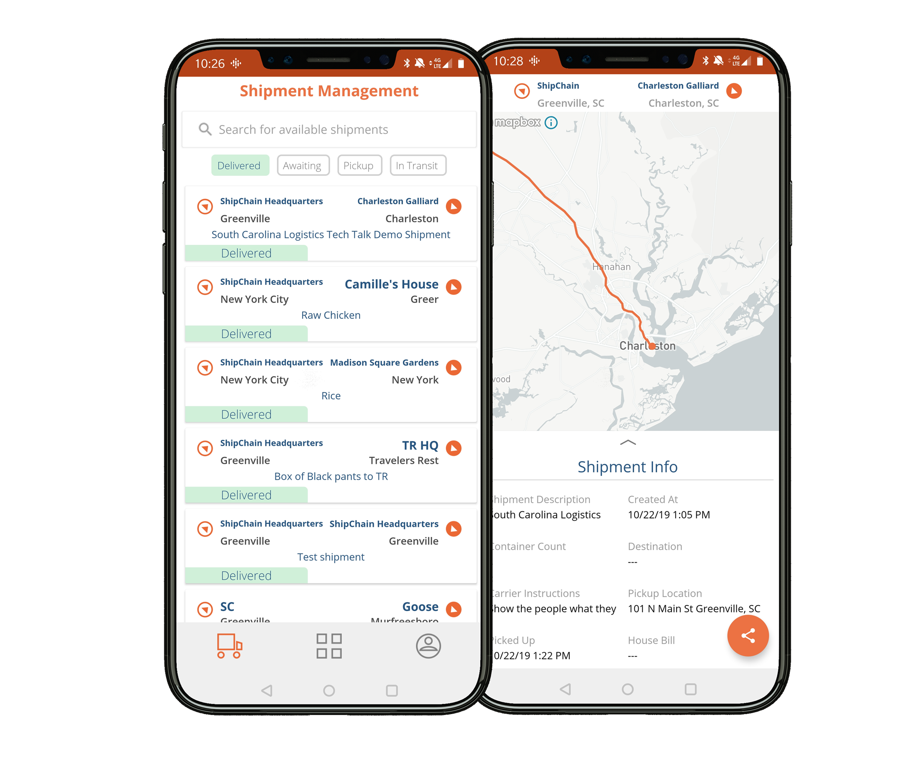
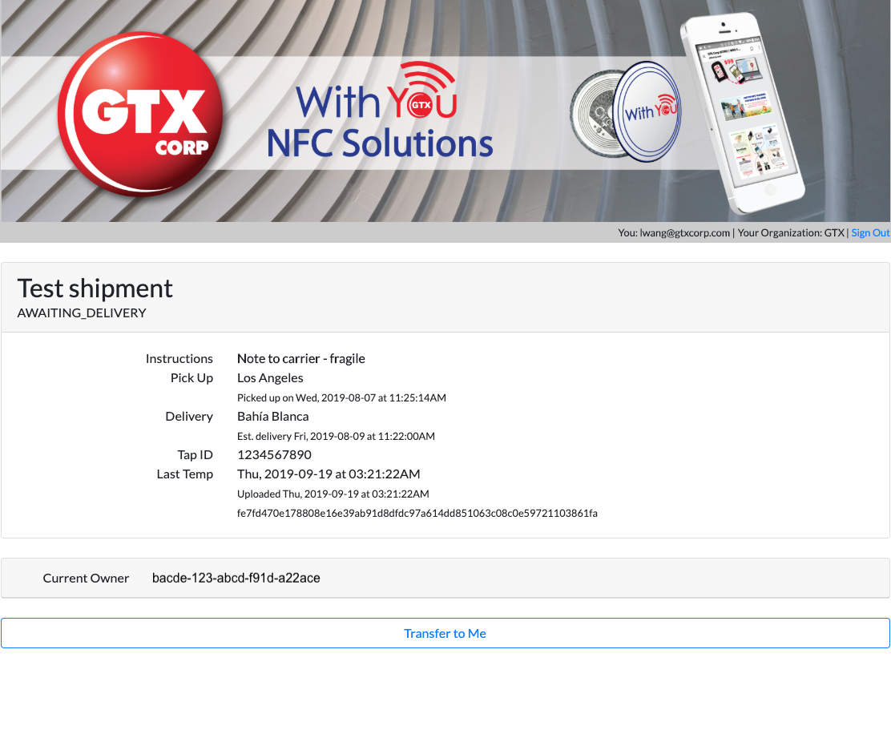
Data Report Screenshots

Slide 17
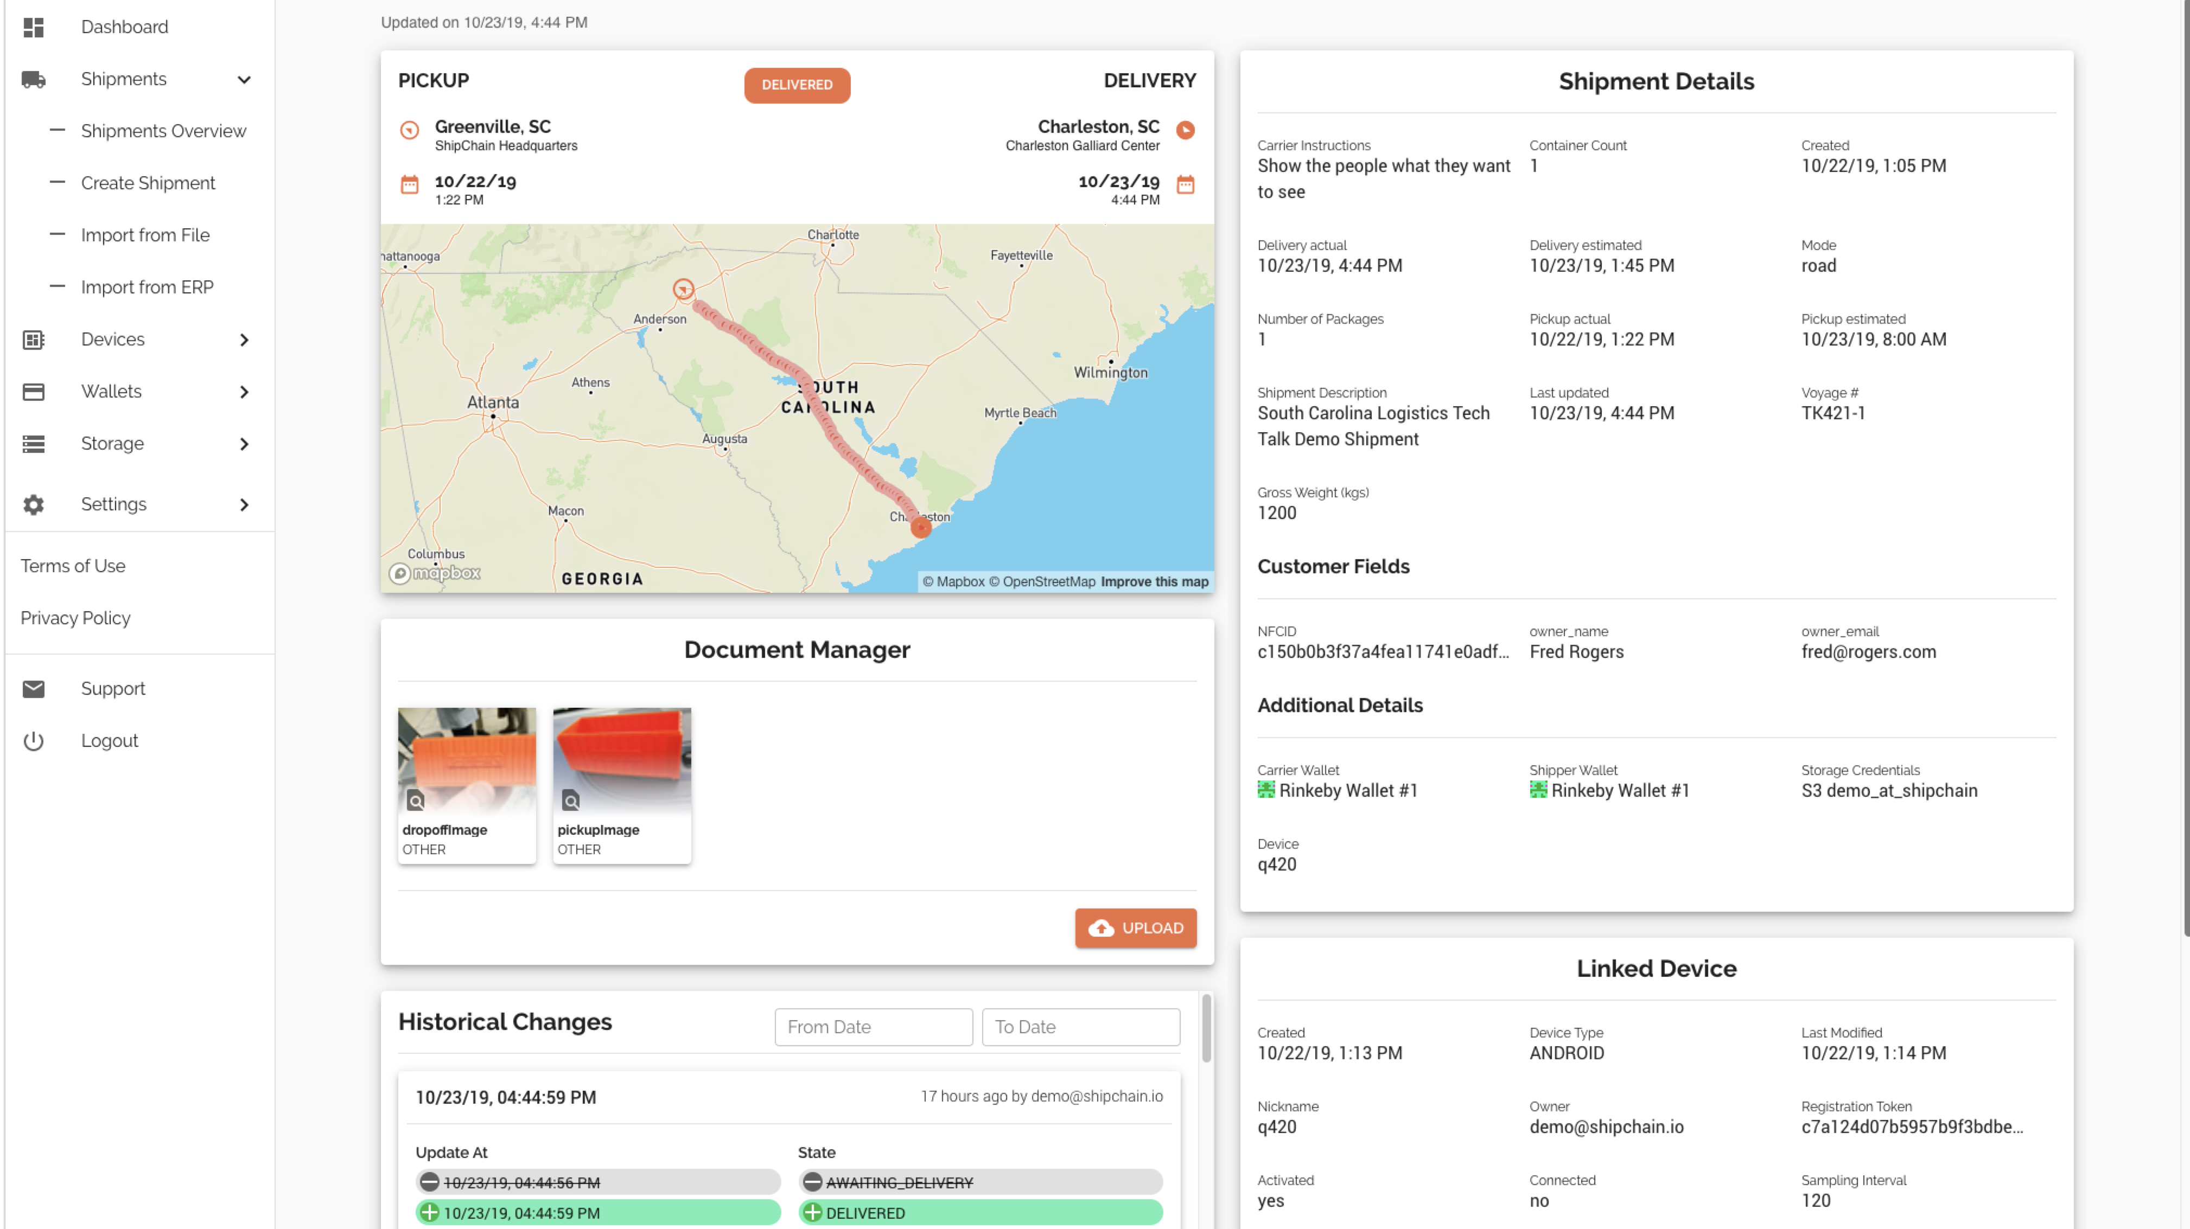
Data Reports

Slide 18
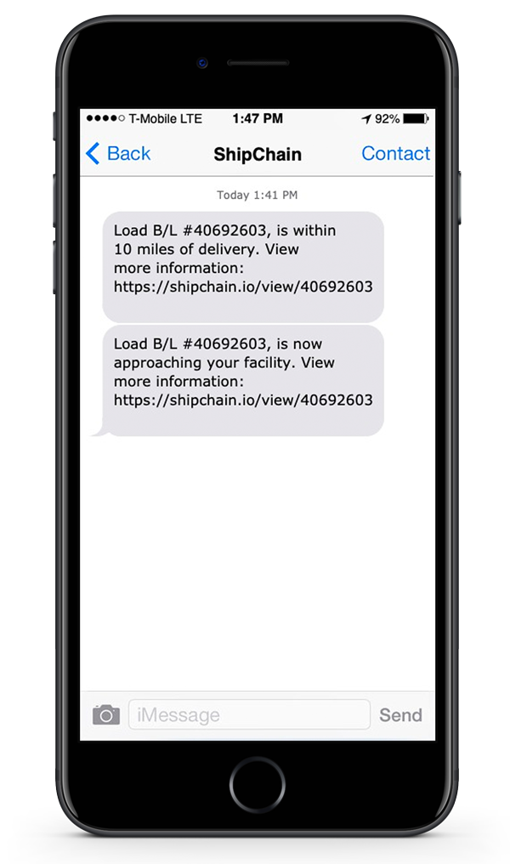
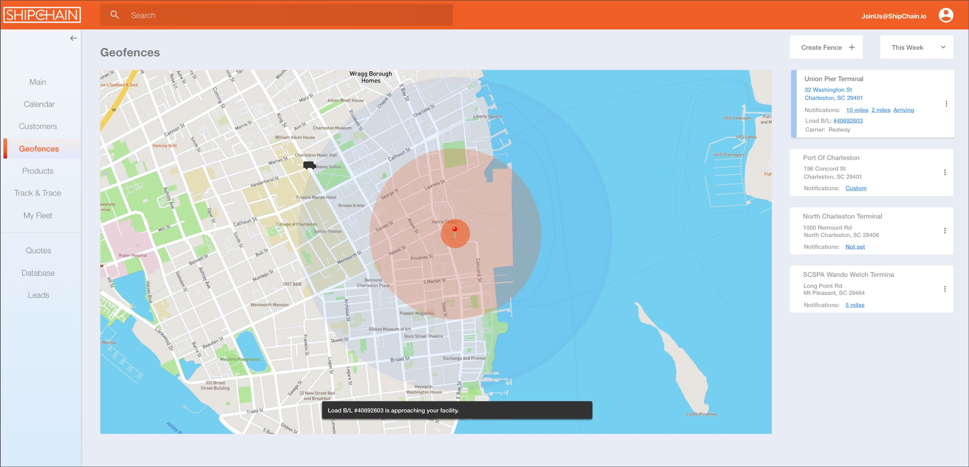
GEOFENCING
Full visibility into the location of your shipments in real-time.
Receive notifications when your shipments are within a given range.
Reducing detention costs and chargebacks with receivers.
Can integrate with existing hardware or we can supply low cost hardware.
Reduced waiting costs of employees.

Slide 19
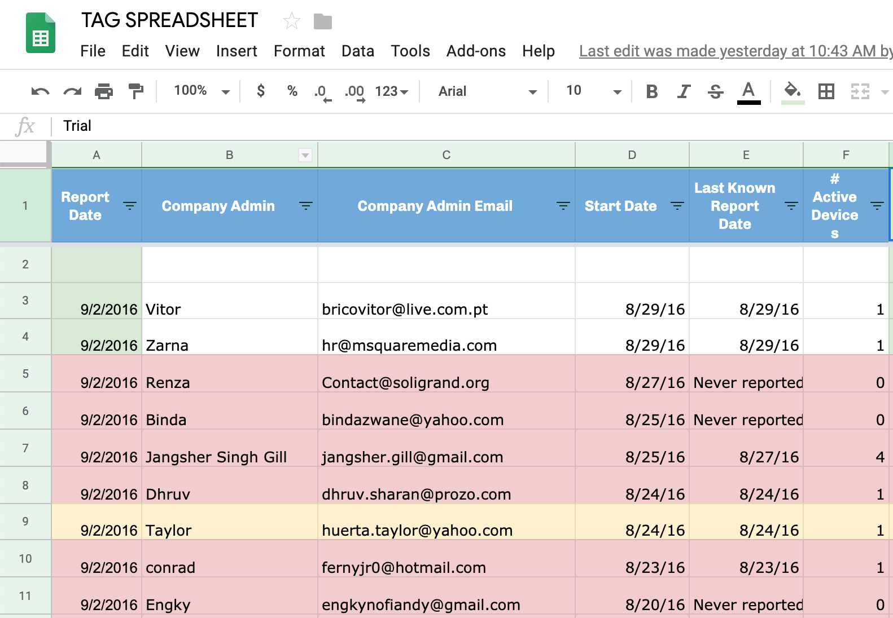
We Offer a One Stop Shop
LABELS
Custom and Small Run Ordering
Portal and Mobile App
Hosting
Encryption/ Security
Blockchain
API integration
LIVE ONLINE DATABASE INTEGRATION
If you are just starting out with NFC or looking to implement a robust and secure supply chain management solution, contact us for a consultation on how to implement.
info@gtxcorp.com 213-489-3019

